Slide 1
Project Managment
Dr. Ibahim Elsemman

Slide 2
Lecture 1: Why do need PM in making software?

Slide 3
The problem
Lecture 1
Developing Software does not mean writing algorithms.
We MUST plan when we are developing Software.

Slide 4

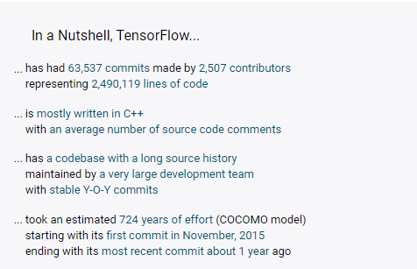
Please comment about this

Slide 5
Please comment about this
Project Scope
Team
Language
Time

Slide 6
Do we really need project managment in software developlment?
A survey of hundreds of corporate software development projects indicated that five out of six software projects are considered unsuccessful [Johnson 95], and approximately a third of software projects are canceled. The remaining projects delivered software at almost double the expected budget and time to develop as originally planned.
William J. Brown et al, AntiPatterns Refactoring Software, Architectures, and Projects in Crisis

Slide 7
Simple Equation
Devloping Software = project
We learn project mangement to make good softwares.

Slide 8
Agree or do not agree
Software is a collection alghorithm.
We should write algorithms to make a new software.

Slide 9
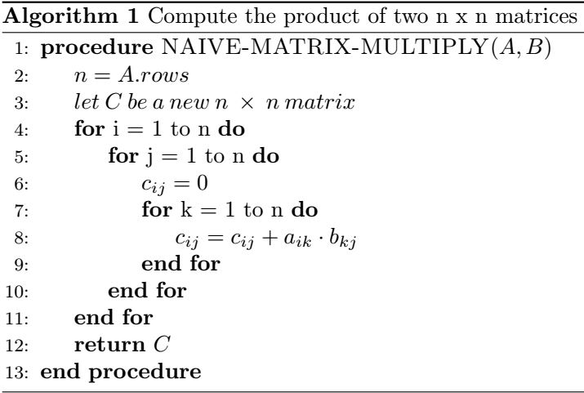
Example

Slide 10
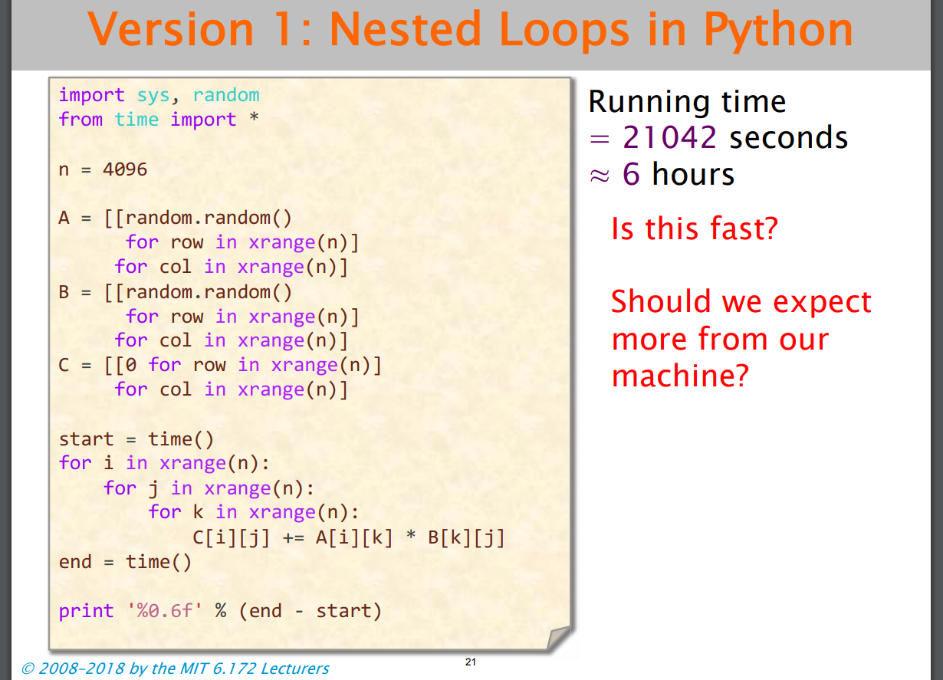

Slide 11
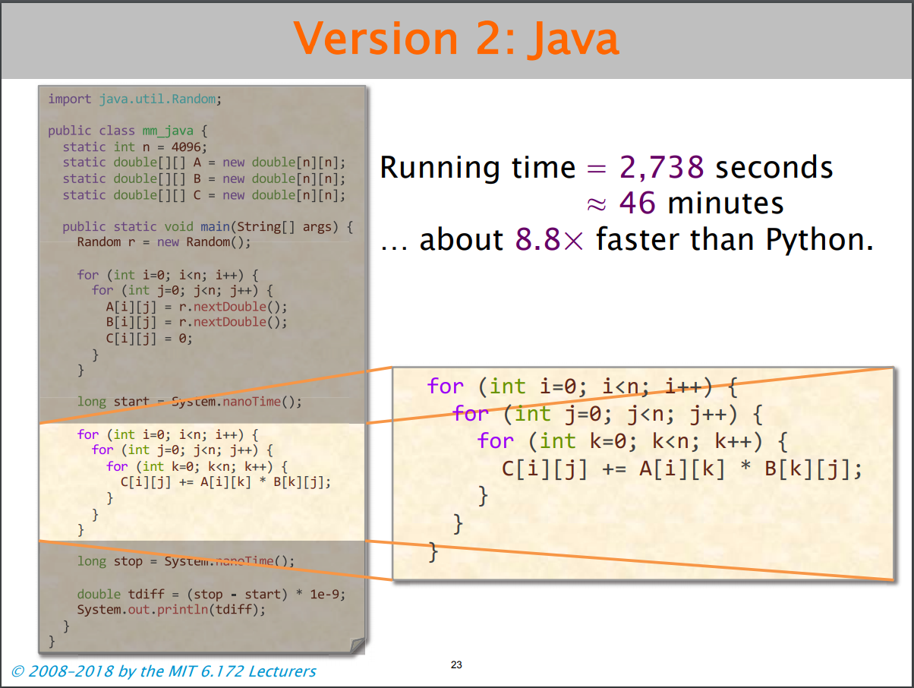

Slide 12
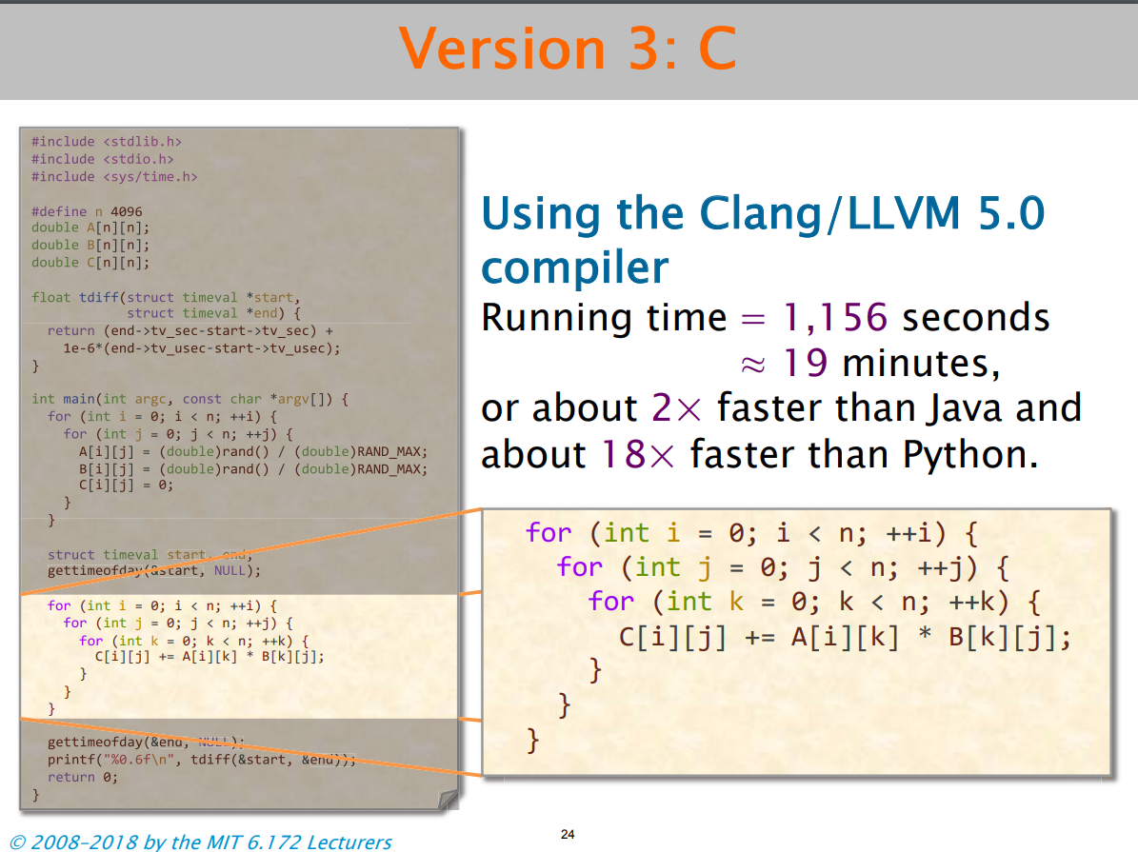

Slide 13
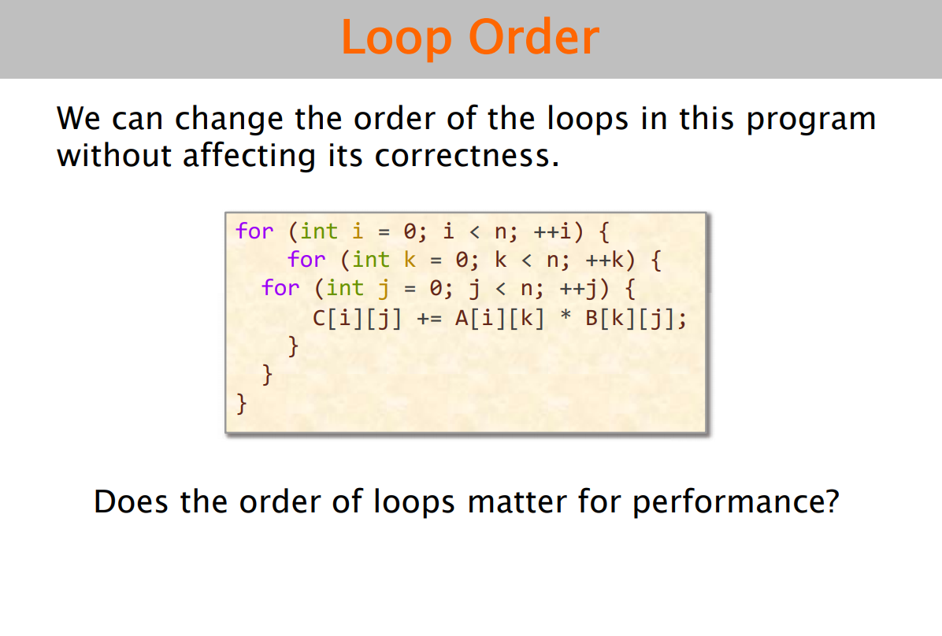

Slide 14
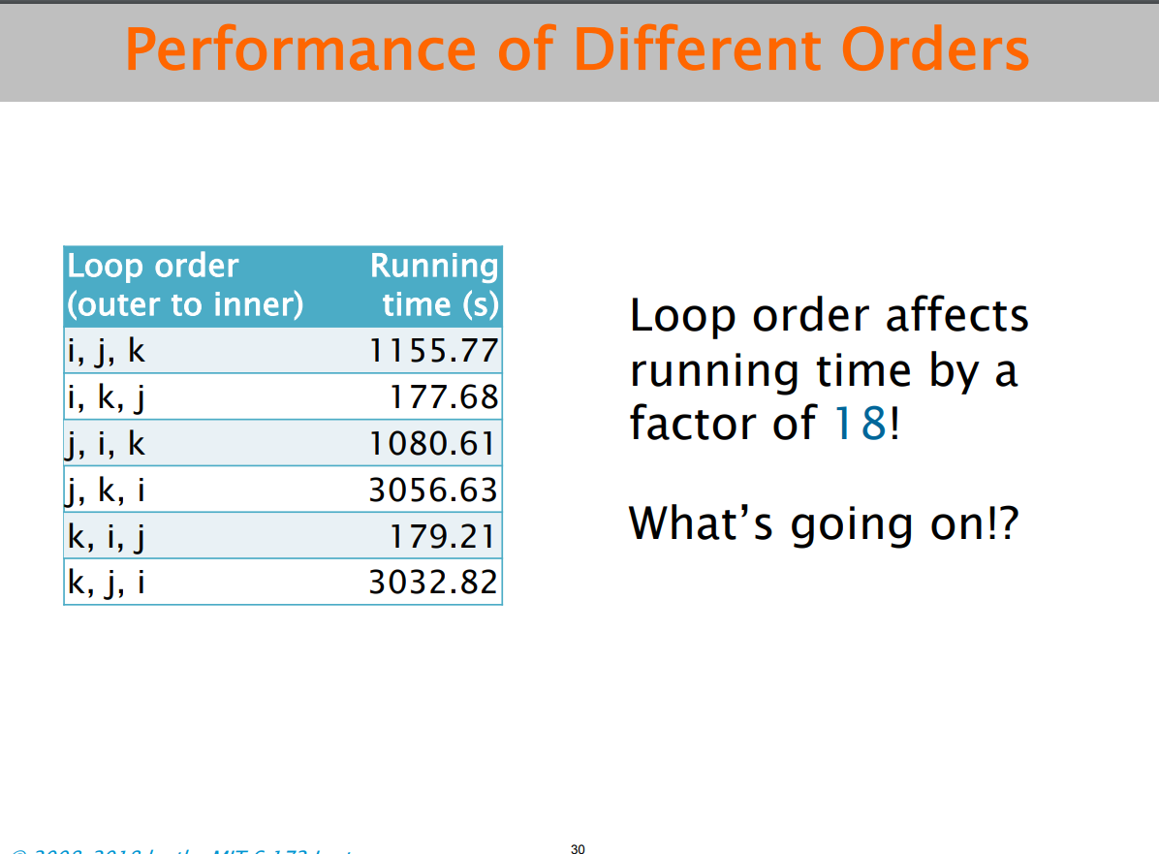

Slide 15
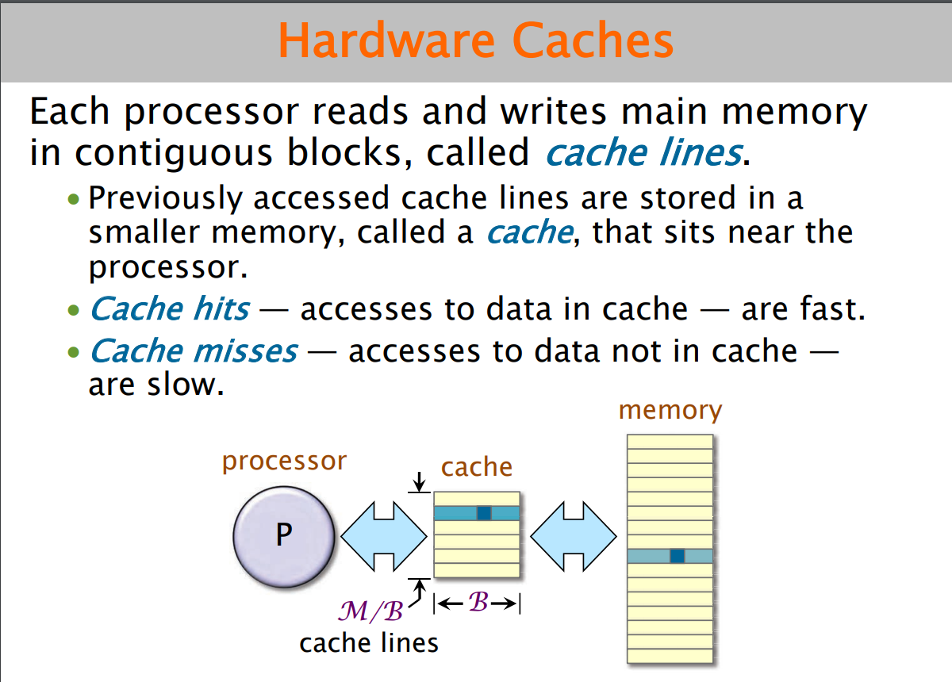

Slide 16
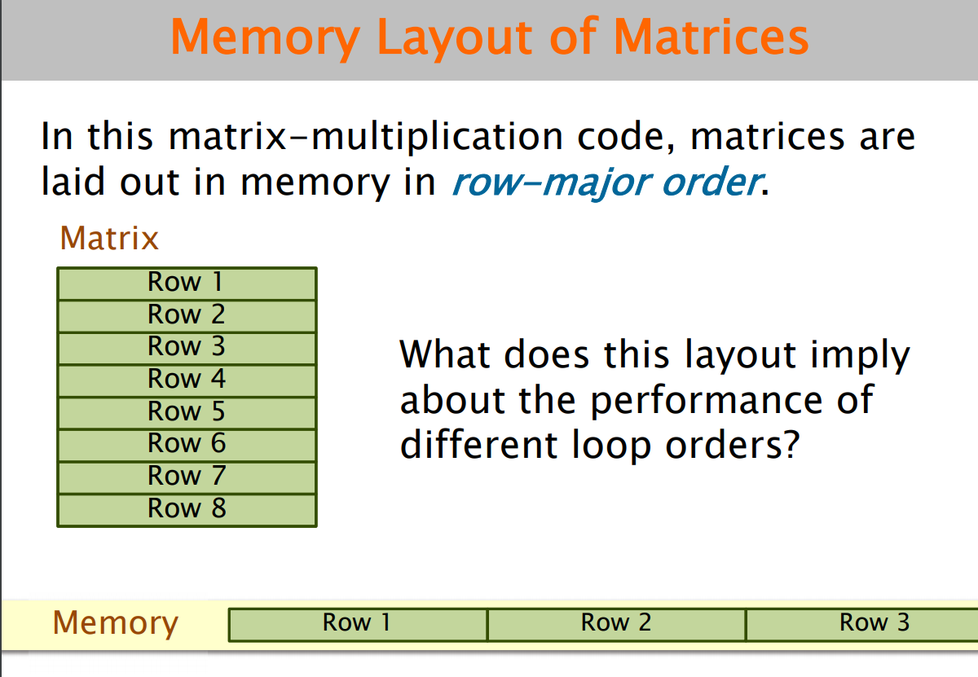

Slide 17
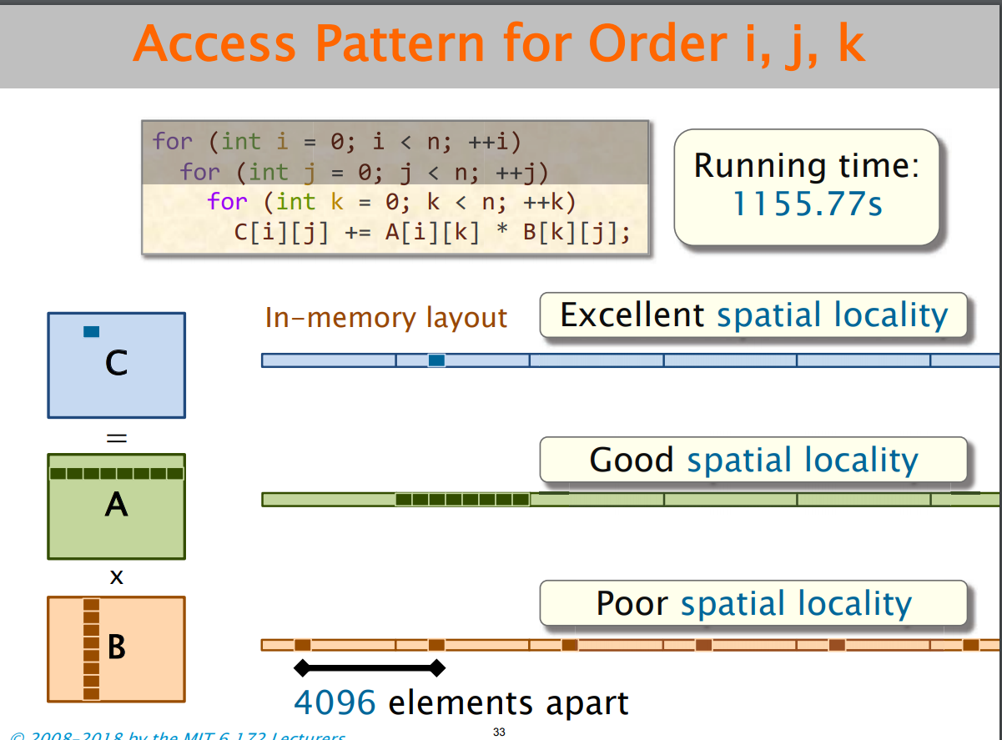

Slide 18
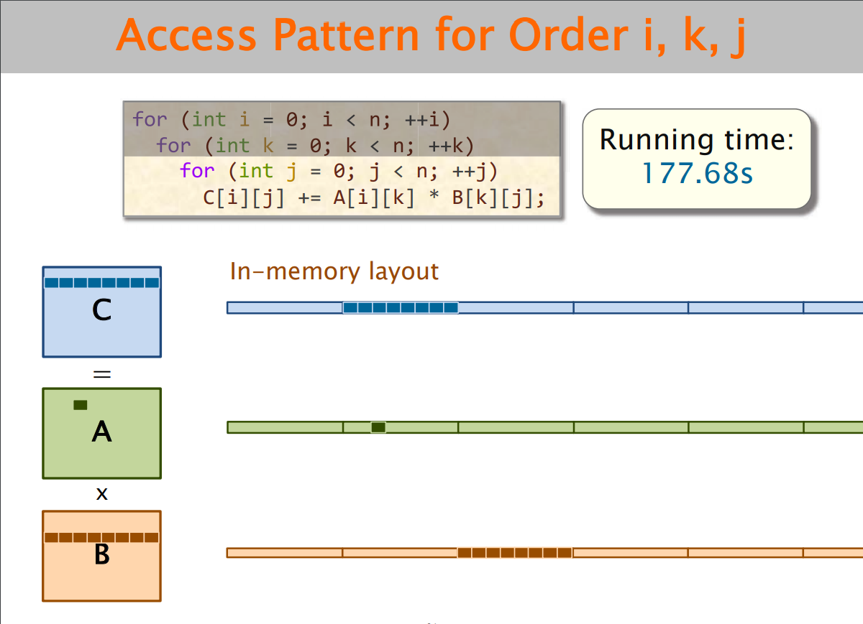

Slide 19
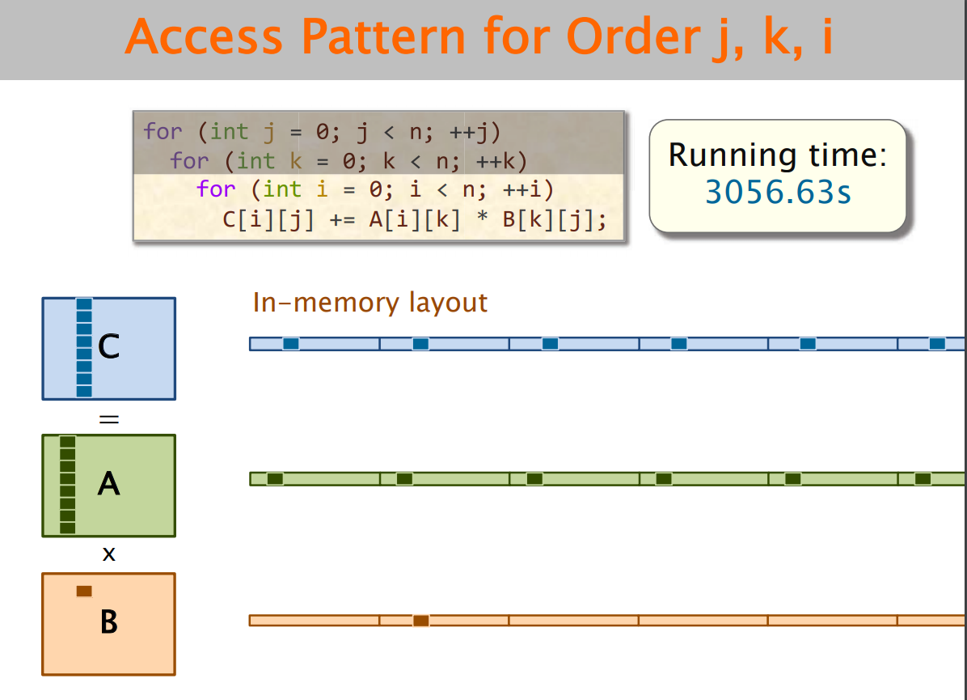

Slide 20
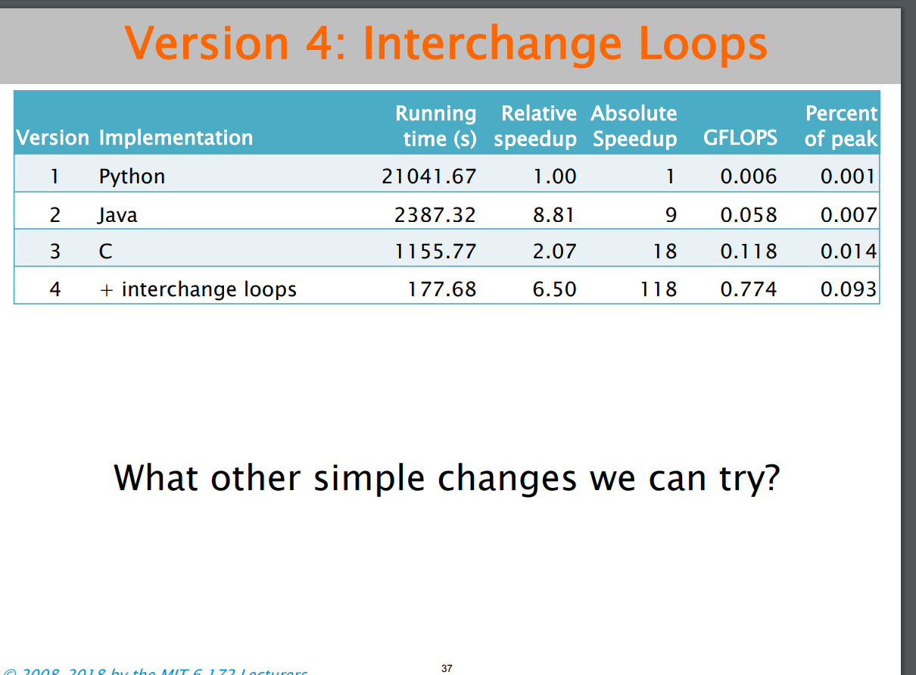

Slide 21
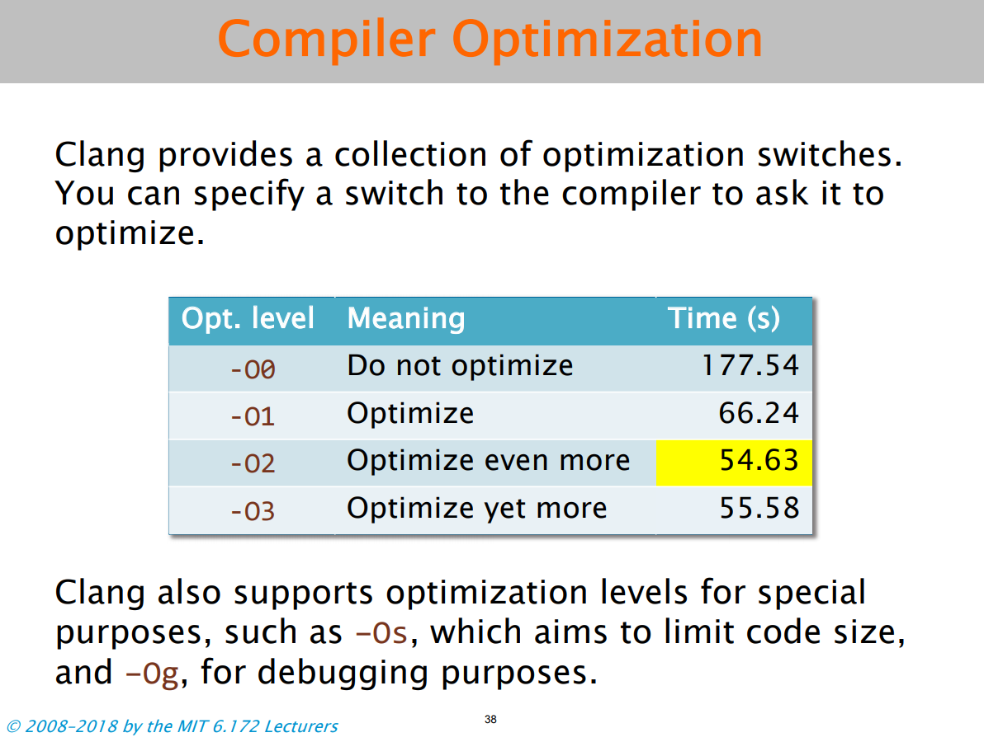

Slide 22
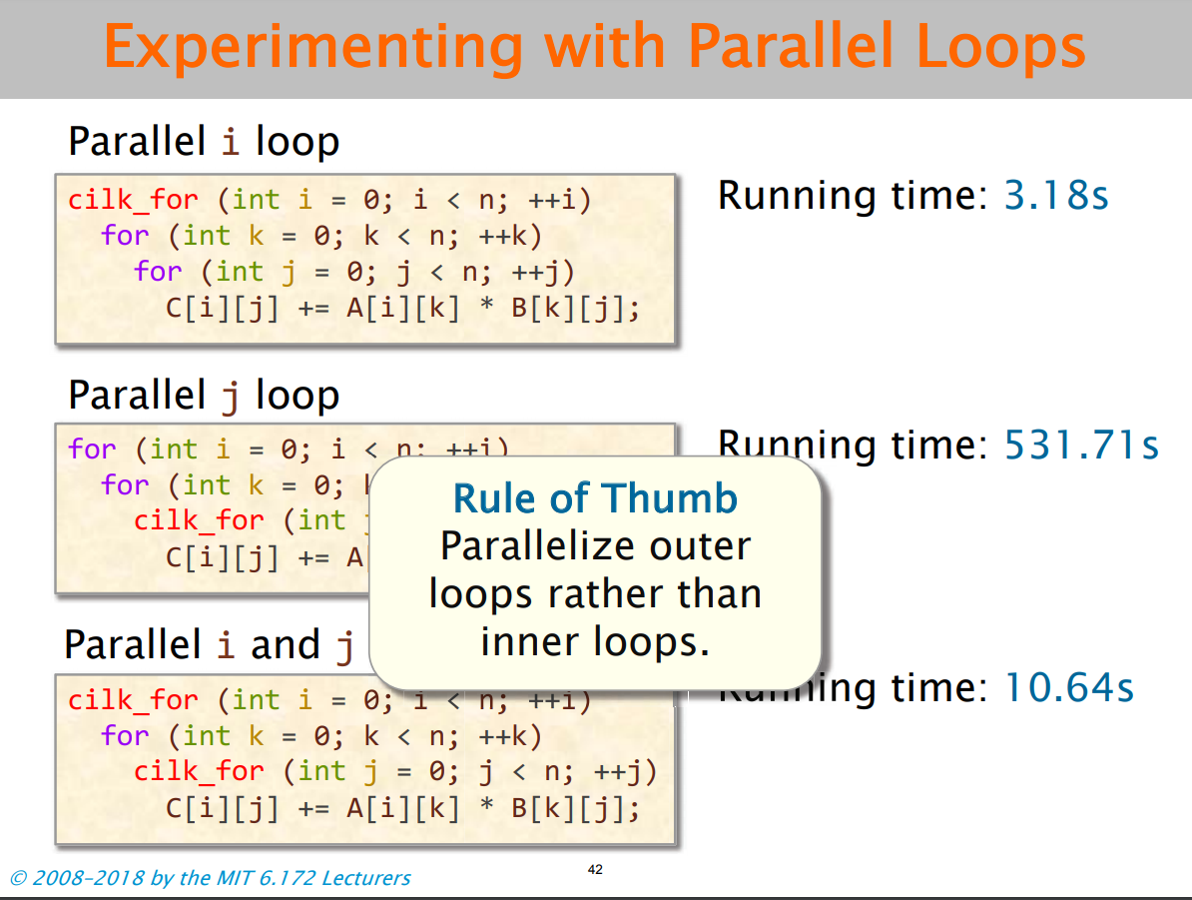

Slide 23
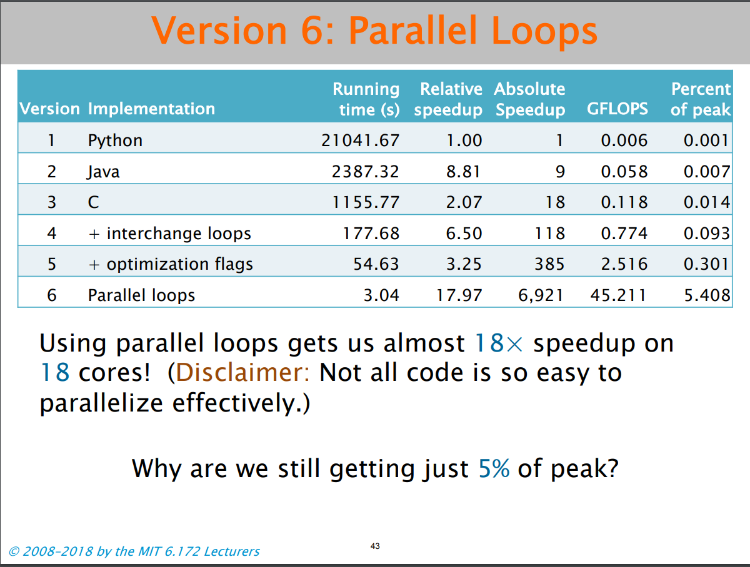

Slide 24
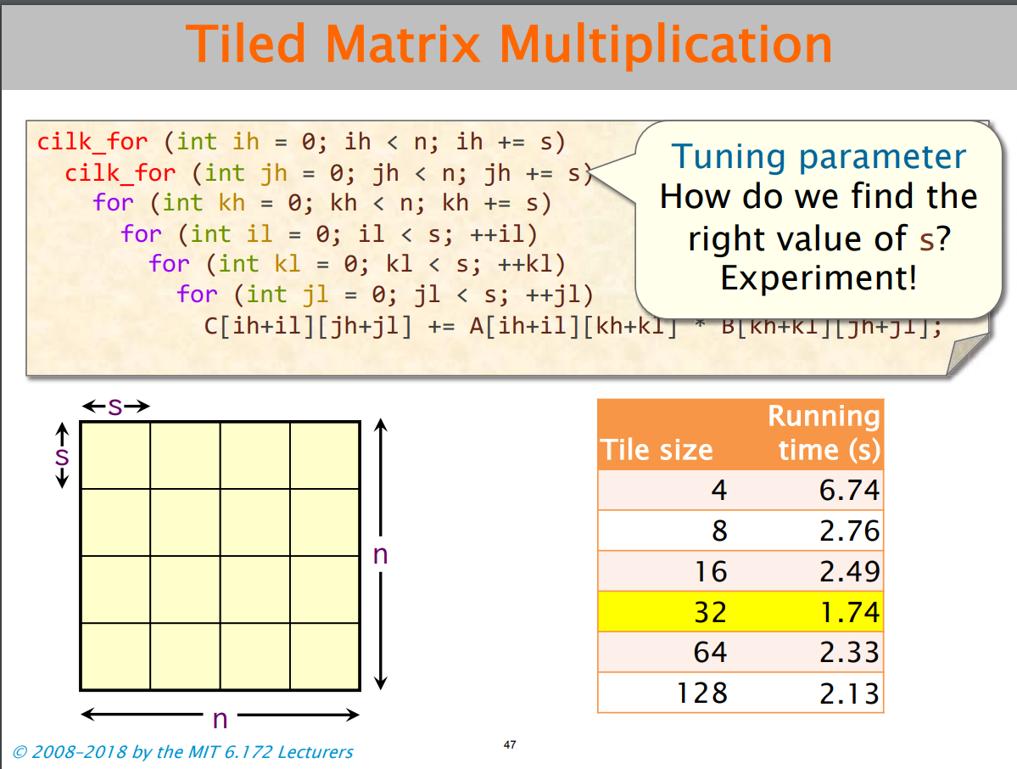

Slide 25
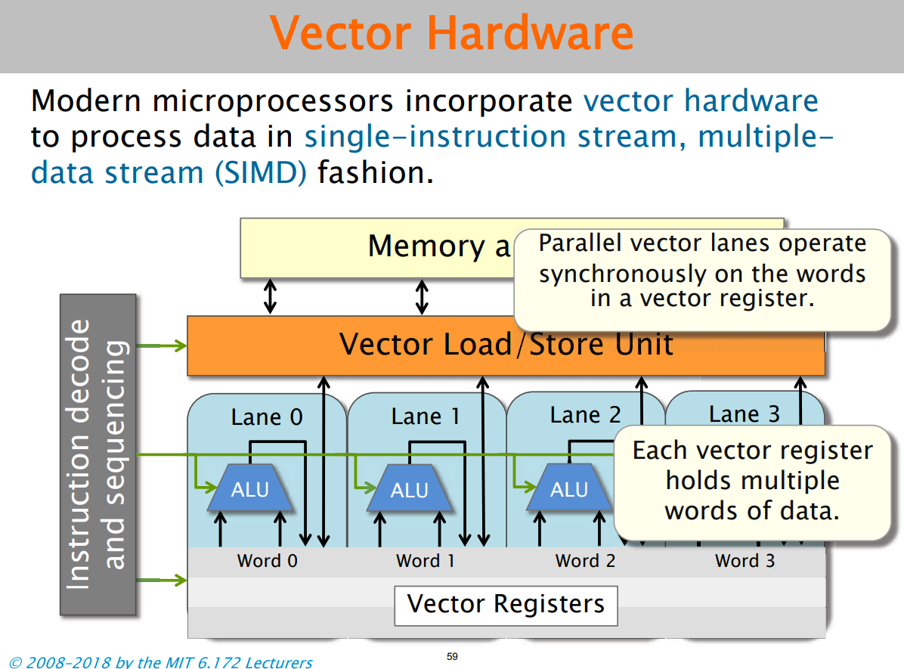

Slide 26
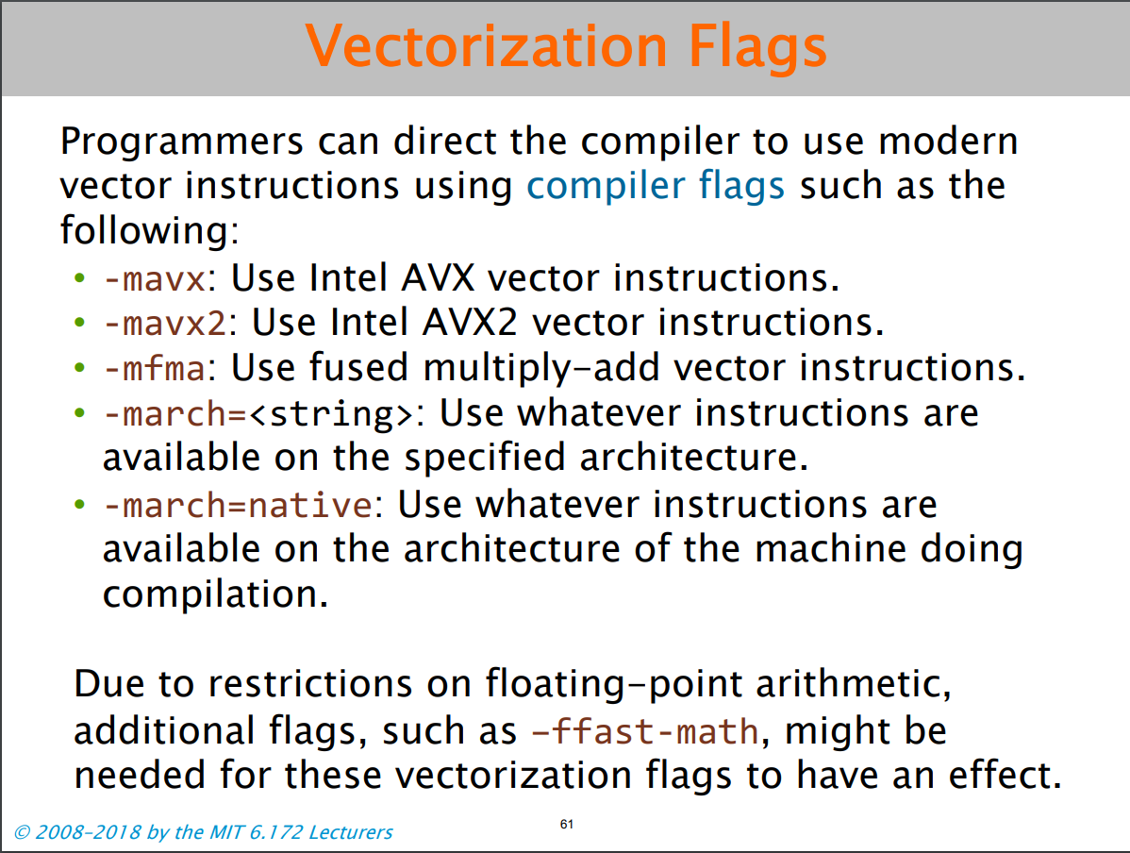

Slide 27
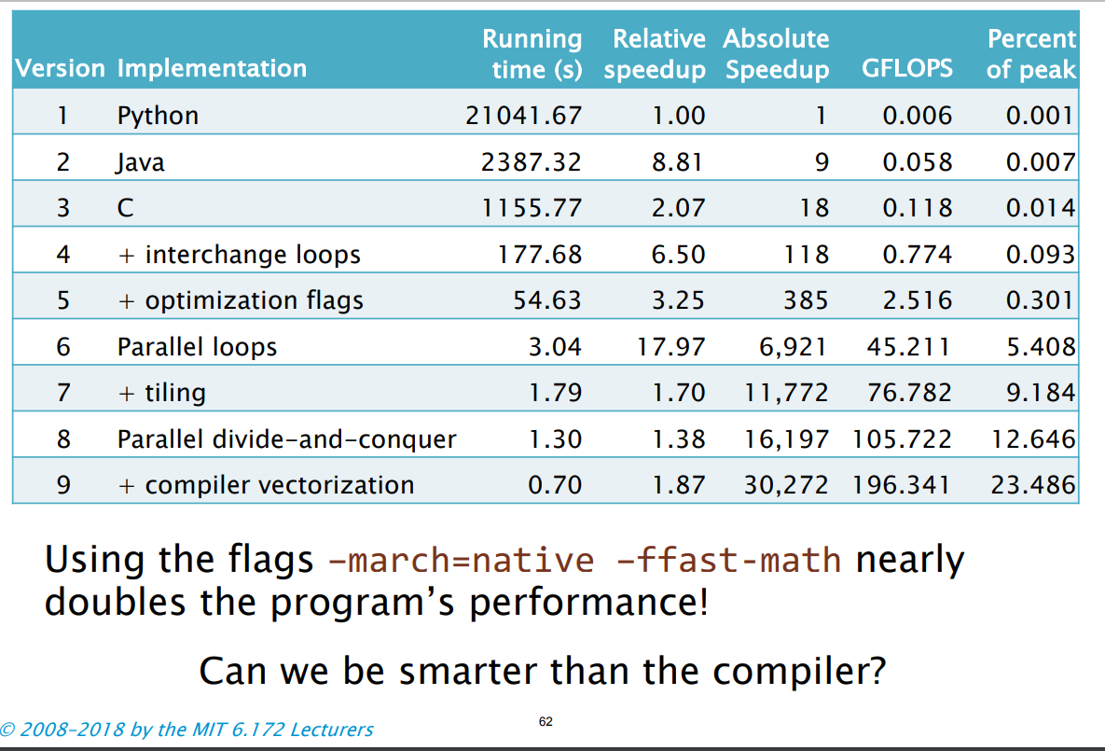

Slide 28


Slide 29
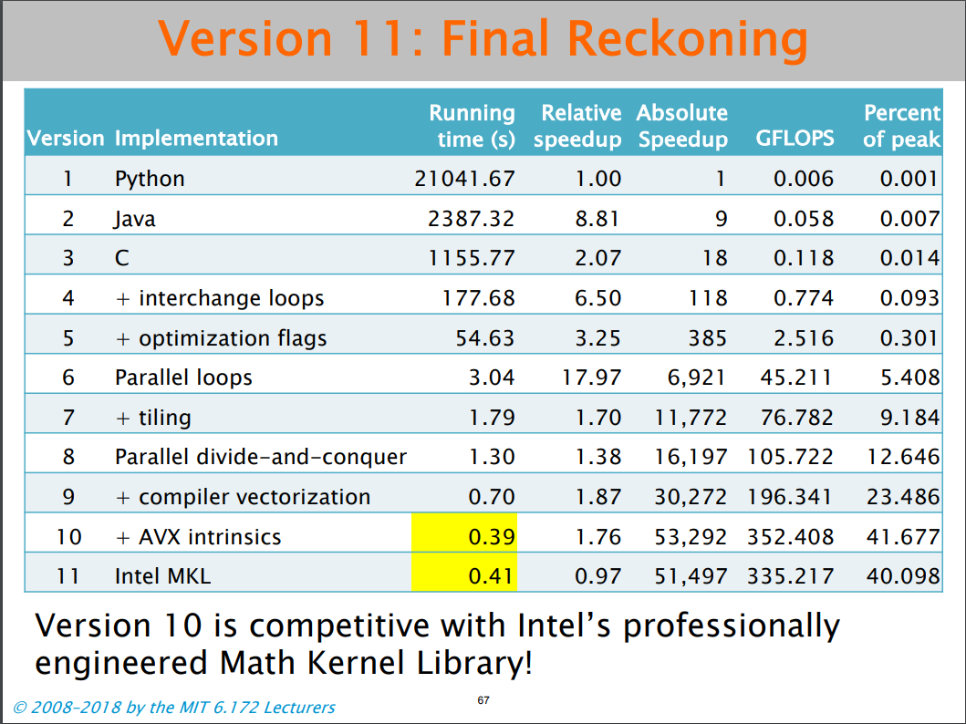

Slide 30
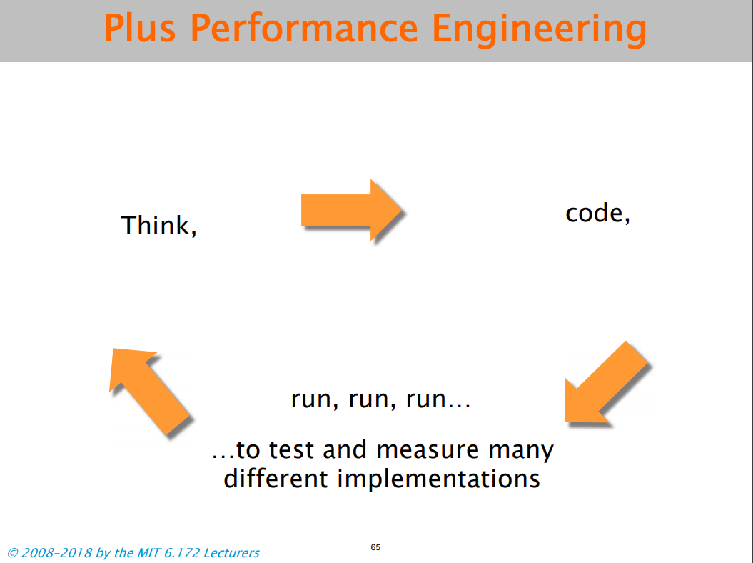
We are here

Slide 31
Agree or do not agree
Software is a collection alghorithm.
We should write algorithms to make a new software.

Slide 32
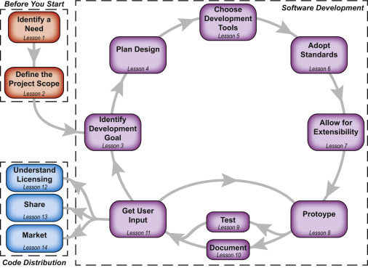
Software Development Process
Visual Description of How the 14 steps during the Software Development Process

Slide 33
Building software is not easy task.
We have to plan and uses resources efficiently.

Slide 34
I am not teaching software Engineering course.
But I teach you what is project mangement? How can you use project managment skills to make good software or information systems.
Please remember this ”A survey of hundreds of corporate software development projects indicated that five out of six software projects are considered unsuccessful [Johnson 95], and approximately a third of software projects are canceled. The remaining projects delivered software at almost double the expected budget and time to develop as originally planned.”

Slide 35
Lecture 2: What is Project

Slide 36
What Is a Project?
A project is a temporary endeavor undertaken to create a unique product, service, or result.

Slide 37
Project Management is rapidly becoming a standard way of doing business.

Slide 38
What is a program?
A program is a group of related projects designed to accomplish a common goal over an extended period of time.
Each project within a program has a project manager. The major differences lie in scale and time span.
Program management is the process of managing a group of ongoing, interdependent, related projects in a coordinated way to achieve strategic objectives.

Slide 39
The major characteristics of a project
1. An established objective.
2. A defined life span with a beginning and an end.
3. Usually, the involvement of several departments and professionals.
4. Typically, doing something that has never been done before.
5. Specific time, cost, and performance requirements.

Slide 40
What a Project Is Not?
Projects should not be confused with everyday work. A project is not routine, repetitive work! Ordinary daily work typically requires doing the same or similar work over and over, while a project is done only once; a new product or service exists when the project is completed. Examine the list in The next Table that compares routine, repetitive work and projects. Recognizing the difference is important because too often resources can be used up on daily operations which may not contribute to longer range organization strategies that require innovative new products.

Slide 41
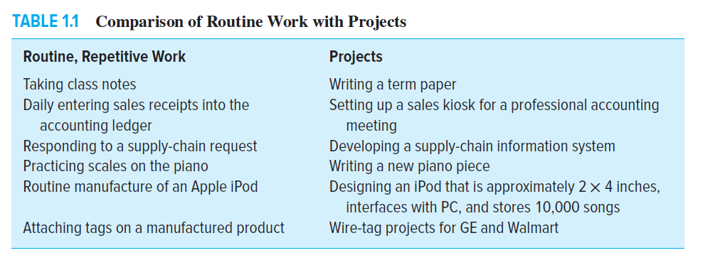

Slide 42
The Project Life Cycle
Defining stage: Specifications of the project are defined; project objectives are established; teams are formed; major responsibilities are assigned.
Planning stage: The level of effort increases, and plans are developed to determine what the project will entail, when it will be scheduled, whom it will benefit, what quality level should be maintained, and what the budget will be.
Executing stage: A major portion of the project work takes place—both physical and mental. The physical product is produced (a bridge, a report, a software program). Time, cost, and specification measures are used for control. Is the project on schedule, on budget, and meeting specifications? What are the forecasts of each of these measures? What revisions/changes are necessary?
Closing stage: Closing includes three activities: delivering the project product to the customer, redeploying project resources, and post-project review.

Slide 43
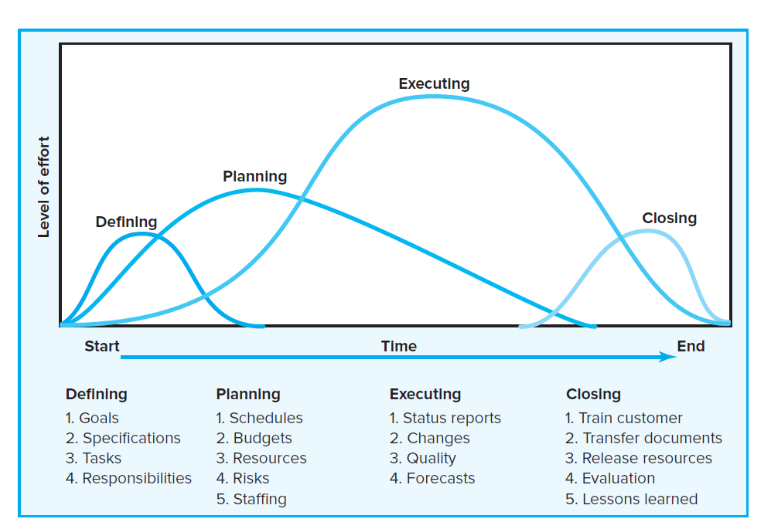

Slide 44
The Project Manager
Good project managers are always in demand. Every industry is looking for effective people who can get the right things done on time.
Project managers are ultimately responsible for performance (frequently with too little authority). They must ensure that appropriate trade-offs are made among the time, cost, and performance requirements of the project.
Project managers must work with a diverse troupe of characters to complete projects. They are typically the direct link to the customer and must manage the tension between customer expectations and what is feasible and reasonable. Project managers provide direction, coordination, and integration to the project team, which is often made up of part-time participants loyal to their functional departments. They often must work with a cadre of outsiders—vendors, suppliers, subcontractors—who do not necessarily share their project allegience.
Project managers must decide what and how things should be done instead of simply managing set processes. They must meet the challenges of each phase of the project life cycle, and even oversee the dissolution of their operation when the project is completed.

Slide 45
Lecture 3: Project Scope (define)

Slide 46
Software Development Process
Visual Description of How the 14 steps during the Software Development Process

Slide 47
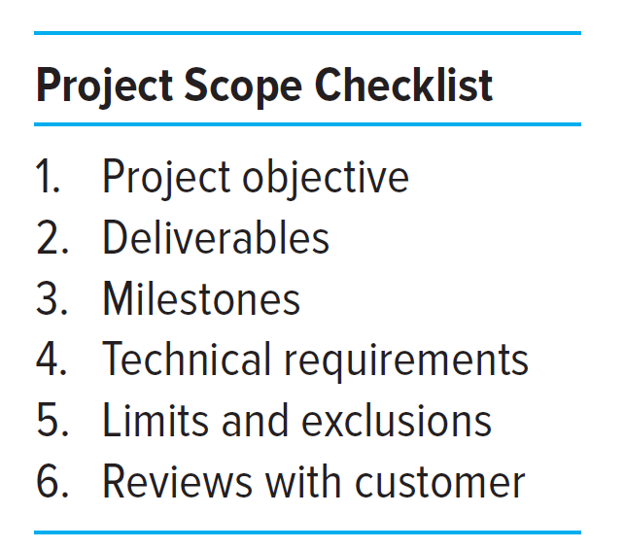
Defining the Project Scope
You should know that:
My project do these, but not do these
World
Project

Slide 48
Project objective. The first step of project scope definition is to define the overall objective to meet your customer’s need(s). For example, as a result of extensive market research a computer software company decides to develop a program that automatically translates verbal sentences in English to Russian. The project should be completed within three years at a cost not to exceed $1.5 million.
Deliverables. The next step is to define major deliverables—the expected, measurable outputs over the life of the project. For example, deliverables in the early design phase of a project might be a list of specifications. In the second phase deliverables could be software coding and a technical manual. The next phase could be the prototype. The final phase could be final tests and approved software. Note: Deliverables and requirements are often used interchangeably.
Milestones. A milestone is a significant event in a project that occurs at a point in time. The milestone schedule shows only major segments of work; it represents first, rough-cut estimates of time, cost, and resources for the project. The milestone schedule is built using the deliverables as a platform to identify major segments of work and an end date—for example, testing complete and finished by July 1 of the same year. Milestones should be natural, important control points in the project. Milestones should be easy for all project participants to recognize.

Slide 49
Technical requirements. More frequently than not, a product or service will have technical requirements to ensure proper performance. Technical requirements typically clarify either the deliverables or define the performance specifications. For example, a technical requirement for a personal computer might be the ability to accept 120-volt alternating current or 240-volt direct current without any adapters or user switches. Another well-known example is the ability of 911 emergency systems to identify the caller’s phone number and location of the phone. Examples from information systems projects include speed and capacity of database systems and connectivity with alternative systems.
Limits and exclusions. The limits of scope should be defined. Failure to do so can lead to false expectations and to expending resources and time on the wrong problem. Examples of limits are: work on site is allowed only between the hours of 8:00 pm - 5:00 am; system maintenance and repair will be done only up to one month after final inspection; client will be billed for additional training beyond that prescribed in the contract. Exclusions further define the boundary of the project by stating what is not included. Examples include: data will be collected by the client, not the contractor; a house will be built, but no landscaping or security devices added; software will be installed, but no training given.
Reviews with customer. Completion of the scope checklist ends with a review with your customer—internal or external. The main concern here is the understanding of and agreement to expectations. Is the customer getting what he or she desires in deliverables? Does the project definition identify key accomplishments, budgets, timing, and performance requirements? Are questions of limits and exclusions covered? Clear communication in all these issues is imperative to avoid claims or misunderstanding.

Slide 50
Please rember this
Scope definition should be as brief as possible but complete; one or two pages are typical for small projects.

Slide 51
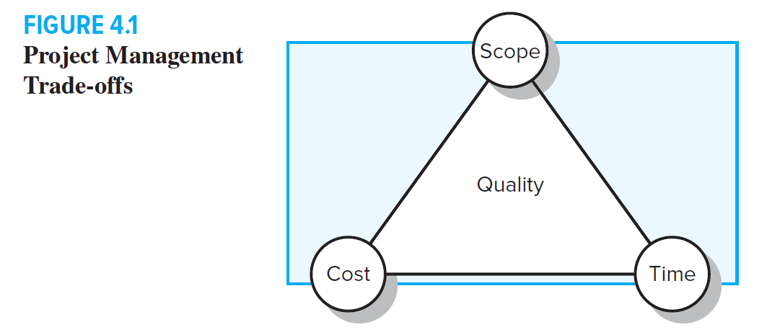
Understand why it is important to establish project priorities in terms of cost, time, and performance.
One of the primary jobs of a project manager is to manage the trade-offs among time, cost, and performance. To do so, project managers must define and understand the nature of the priorities of the project. They need to have a candid discussion with the project customer and upper management to establish the relative importance of

Slide 52
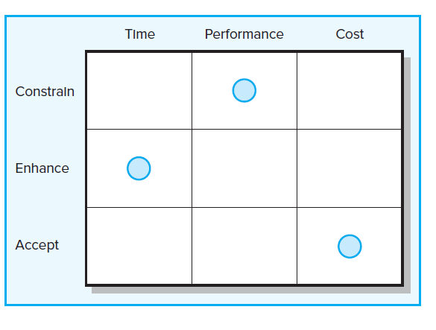
Priority Matrix
One technique found in practice that is useful for this purpose is completing a priority matrix for the project to identify which criterion is constrained, which should be enhanced, and which can be accepted:
Constrain. The original parameter is fixed. The project must meet the completion date, specifications and scope of the project, or budget.
Enhance. Given the scope of the project, which criterion should be optimized? In the case of time and cost, this usually means taking advantage of opportunities to either reduce costs or shorten the schedule. Conversely, with regard to performance, enhancing means adding value to the project.
Accept. For which criterion is it tolerable not to meet the original parameters? When trade-offs have to be made, is it permissible for the schedule to slip, to reduce the scope and performance of the project, or to go over budget?

Slide 53
Step 3: Creating the Work Breakdown Structure (WBS)
Once the scope and deliverables have been identified, the work of the project can be successively subdivided into smaller and smaller work elements. The outcome of this hierarchical process is called the work breakdown structure (WBS). Use of a WBS helps to assure project managers that all products and work elements are identified, to integrate the project with the current organization, and to establish a basis for control. Basically, the WBS is an outline of the project with different levels of detail.

Slide 54
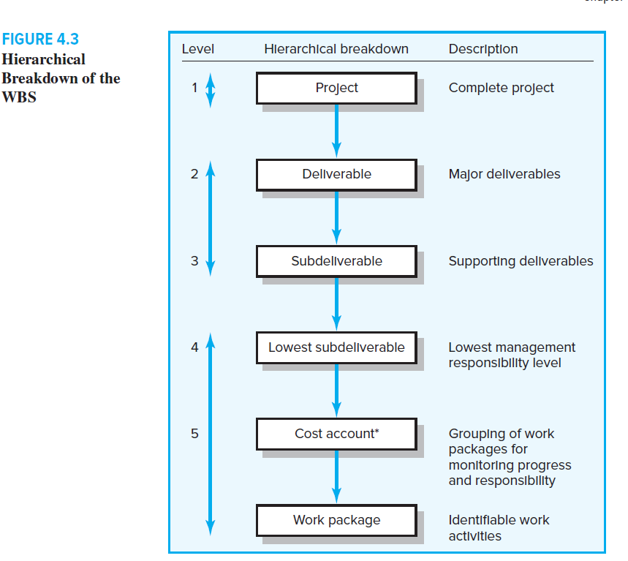

Slide 56
work package
The lowest level of the WBS is called a work package. Work packages are short duration tasks that have a definite start and stop point, consume resources, and represent cost. Each work package is a control point.
1. Defines work (what).
2. Identifies time to complete a work package (how long).
3. Identifies a time-phased budget to complete a work package (cost).
4. Identifies resources needed to complete a work package (how much).
5. Identifies a single person responsible for units of work (who).
6. Identifies monitoring points for measuring progress (how well).

Slide 57
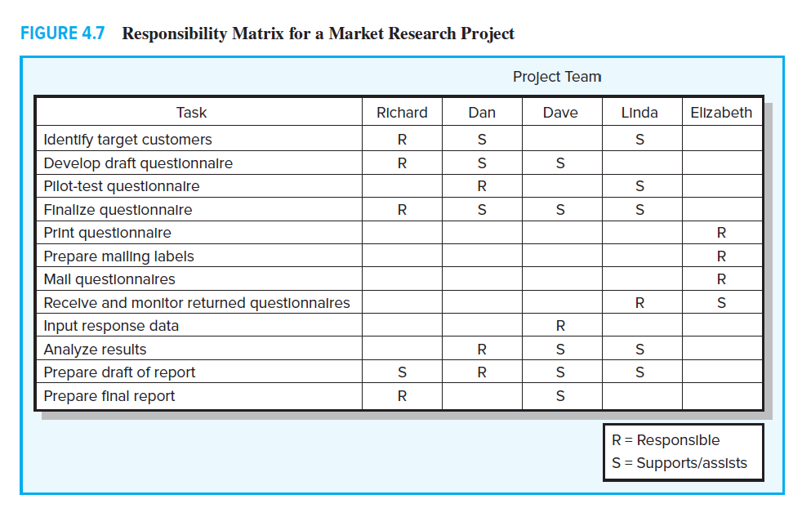
Responsibility Matrix

Slide 58
Process Breakdown Structure
Information systems projects typically fall in this category— for example, creating an extranet website or an internal software database system. Process projects are driven by performance requirements, not by plans/blueprints. Some practitioners choose to utilize what we refer to as a process breakdown structure (PBS) instead of the classic WBS.

Slide 59
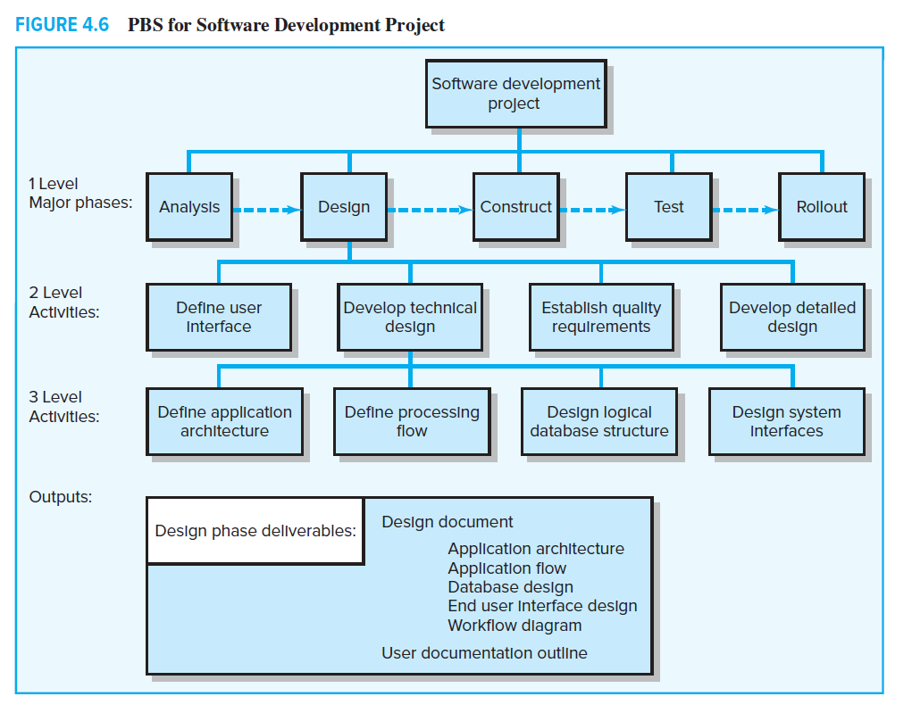

Slide 60
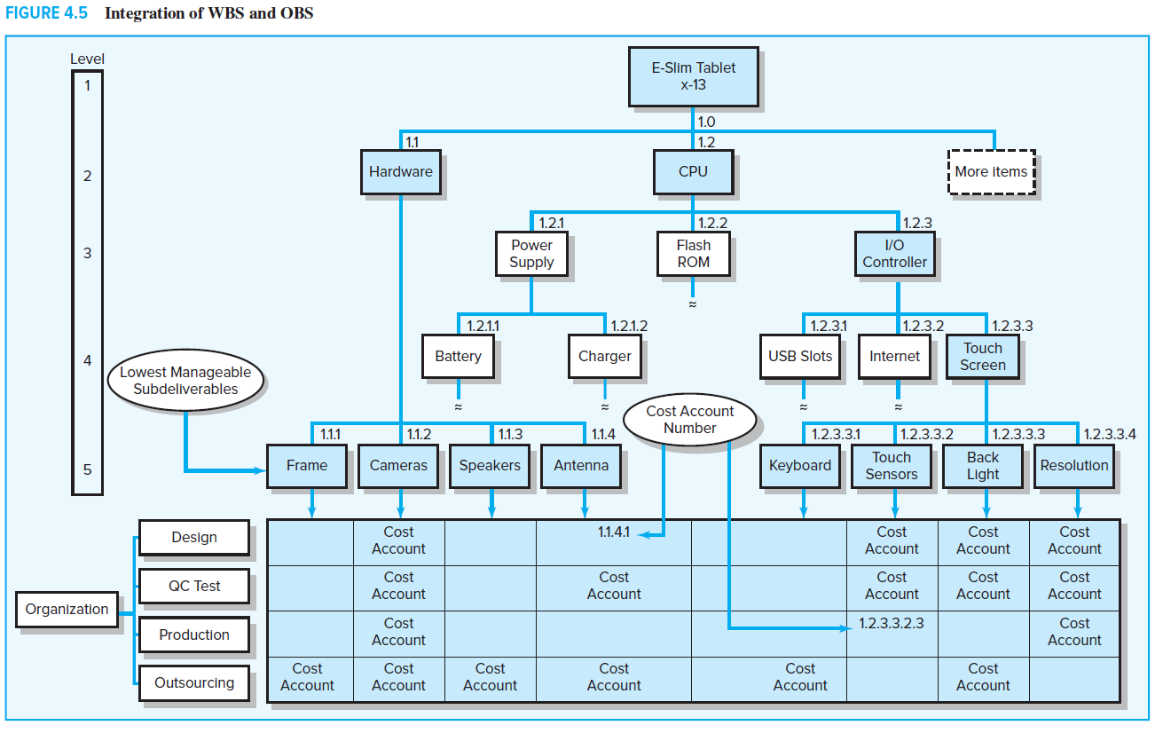
Integration projection with Organization

Slide 61
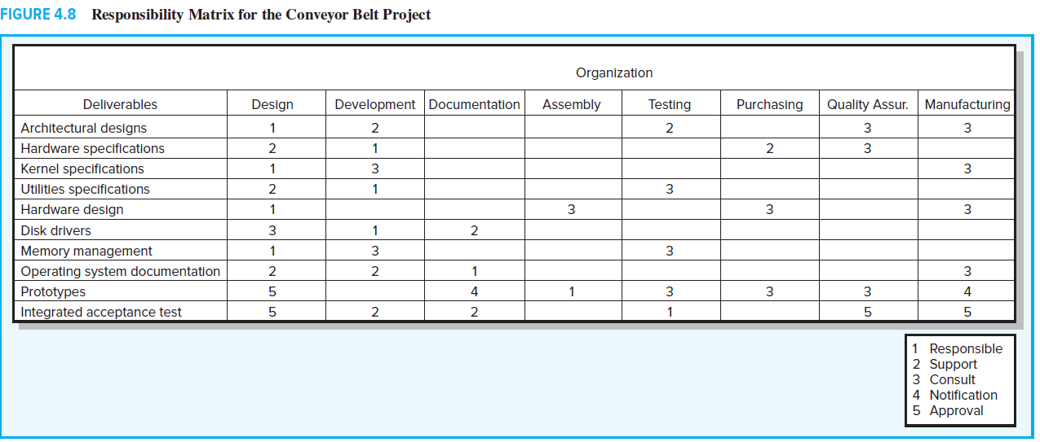

Slide 62
4.8 Project Communication Plan
Once the project deliverables and work are clearly identified, following up with an internal communication plan is vital. Stories abound of poor communication as a major contributor to project failure. Having a robust communications plan can go a long way toward mitigating project problems and can ensure that customers, team members, and other stakeholders have the information to do their jobs.
Project communication plans address the following core questions:
∙ What information needs to be collected and when?
∙ Who will receive the information?
∙ What methods will be used to gather and store information?
∙ What are the limits, if any, on who has access to certain kinds of information?
∙ When will the information be communicated?
∙ How will it be communicated?

Slide 63
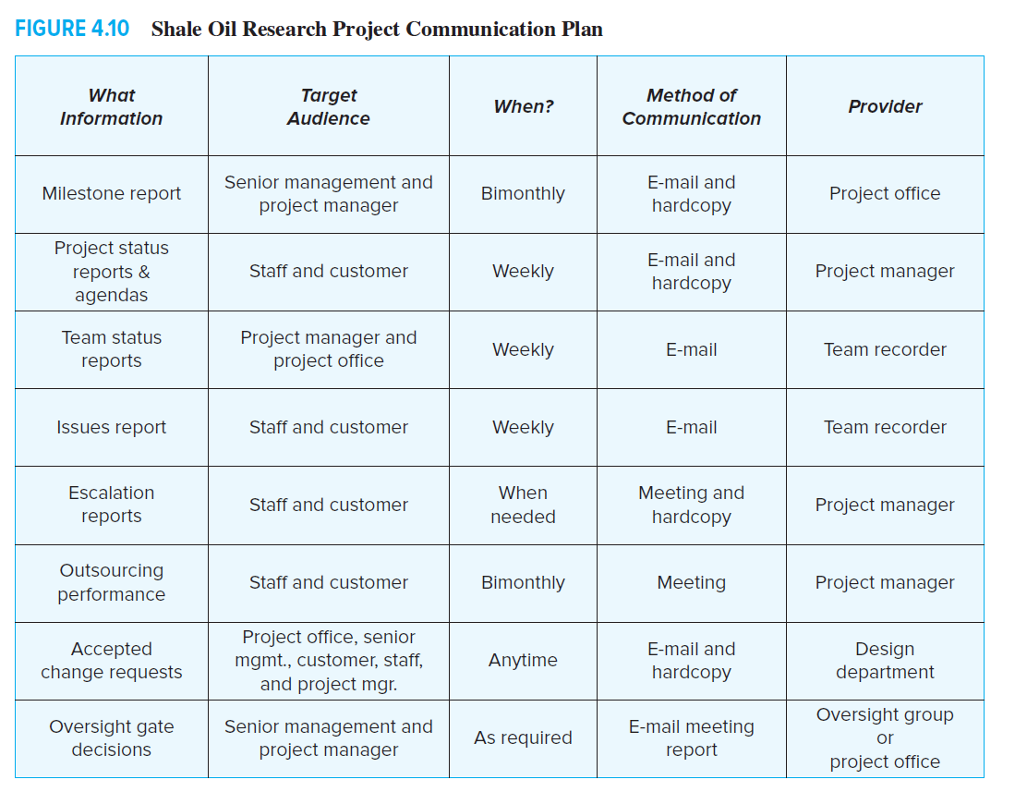

Slide 64
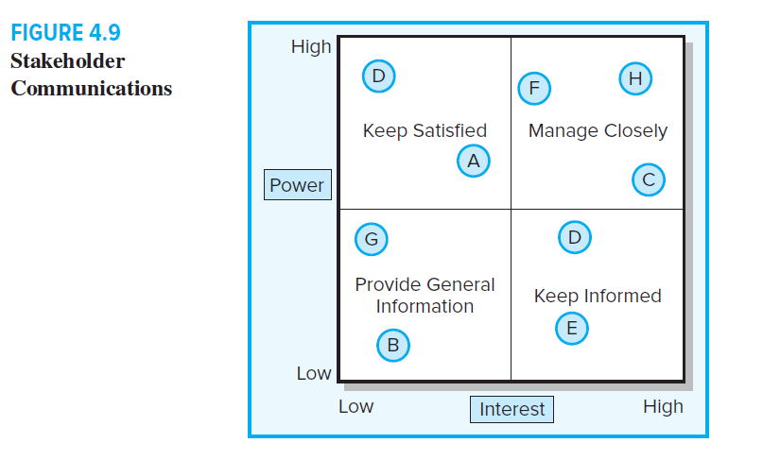
Developing a communication plan that answers these questions usually entails the following basic steps:
Stakeholder analysis. Identify the target groups. Typical groups could be the customer, sponsor, project team, project office, or anyone who needs project information to make decisions and/or contribute to project progress. A common tool found in practice to initially identify and analyze major project stakeholders’ communication needs is presented in the next figure. How and what is communicated is influenced by the stakeholder interest and power. Some of these stakeholders may have the power either to block or enhance your project.

Slide 65
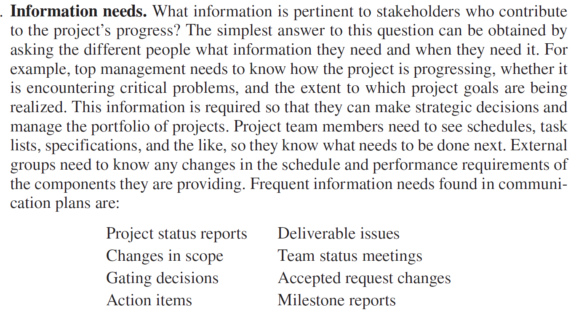

Slide 66
Dissemination modes. In today’s world, traditional status report meetings are being supplemented by e-mail, teleconferencing, SharePoint, and a variety of database sharing programs to circulate information. In particular, many companies are using the Web to create a “virtual project office” to store project information. Project management software feeds information directly to the website so that different people have immediate access to relevant project information.
Sources of information. When the information needs are identified, the next step is to determine the sources of information. That is, where does the information reside? How will it be collected? For example, information relating to the milestone report, team meetings, and project status meetings would be found in the minutes and reports of various groups.
Responsibility and timing. Determine who will send out the information. For example, a common practice is to have secretaries of meetings forward the minutes or specific information to the appropriate stakeholders. In some cases the responsibility lies with the project manager or project office. Timing and frequency of distribution appropriate to the information need to be established.

Slide 67
Lecture 4: Developing a Project Plan

Slide 68
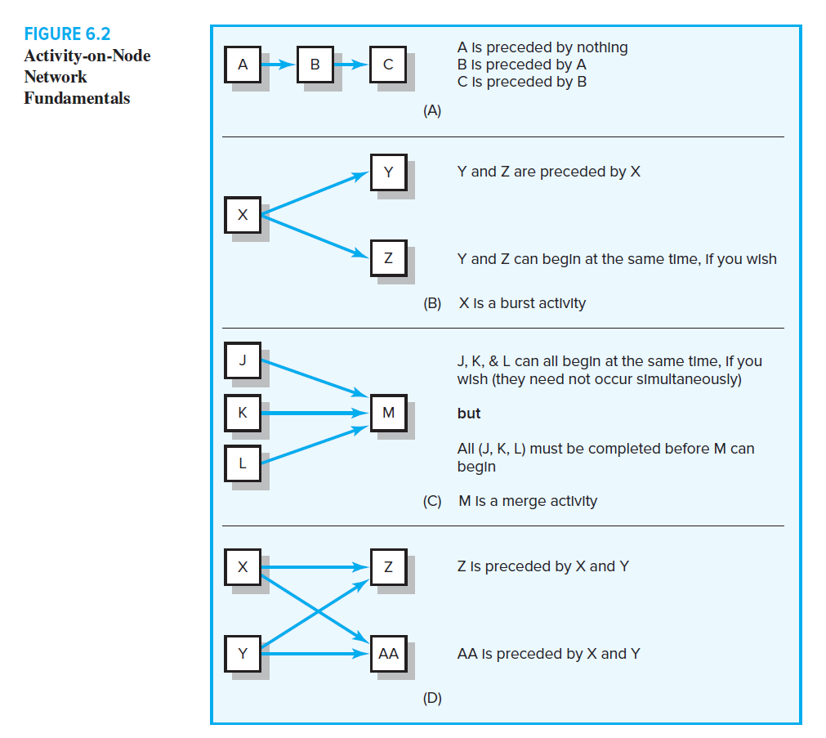
There are three basic relationships that must be established for activities included in a project network. The relationships can be found by answering the following three questions for each activity:
1. Which activities must be completed immediately before this activity? These activities are called predecessor activities.
2. Which activities must immediately follow this activity? These activities are called successor activities.
3. Which activities can occur while this activity is taking place? This is known as a concurrent or parallel relationship.

Slide 69
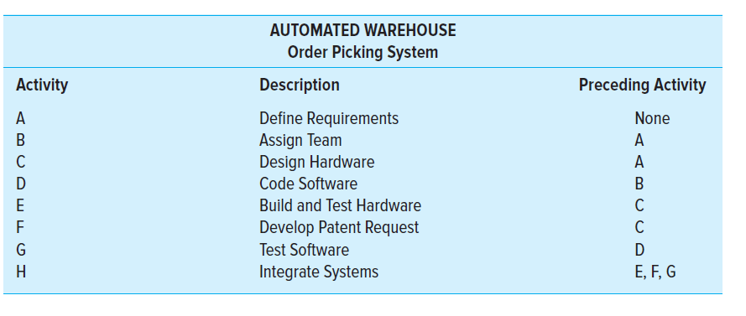
Network Information

Slide 70
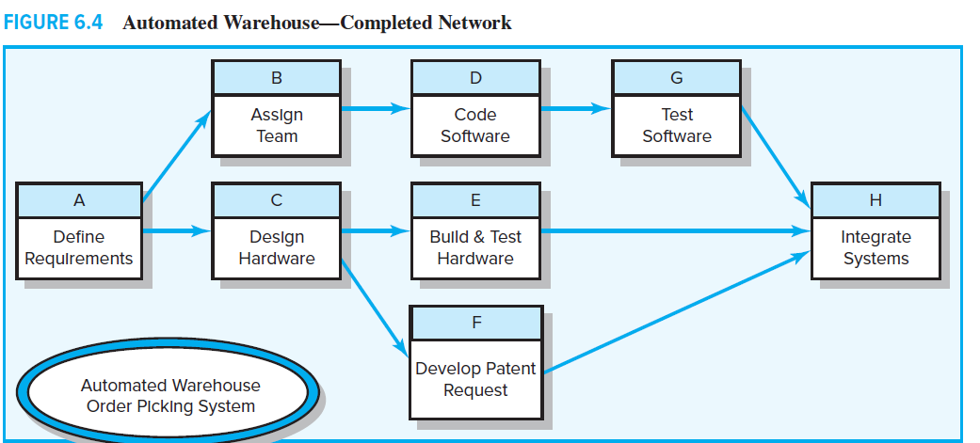

Slide 71
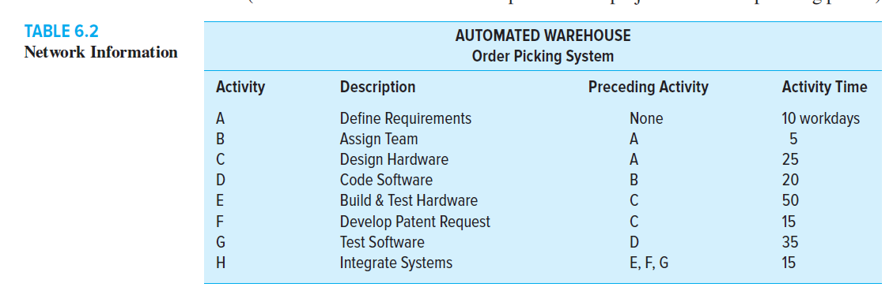
Adding Activity time information

Slide 72
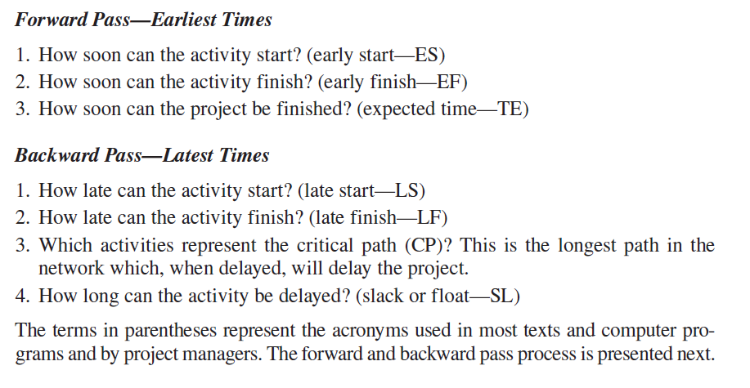

Slide 73
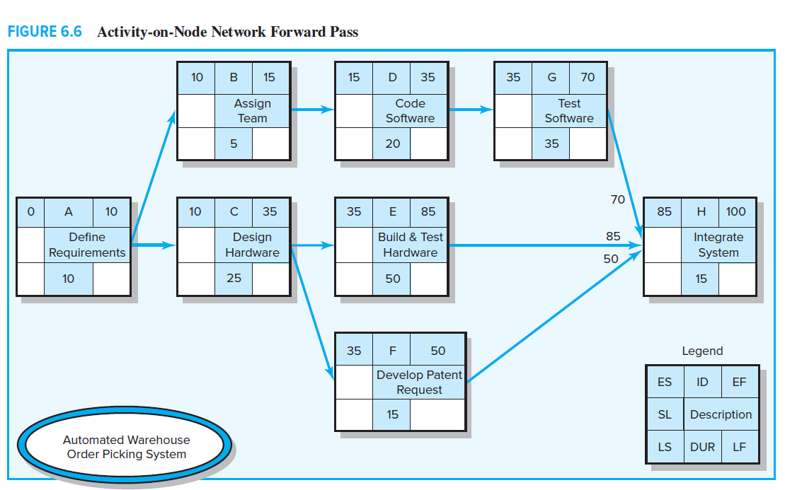

Slide 74
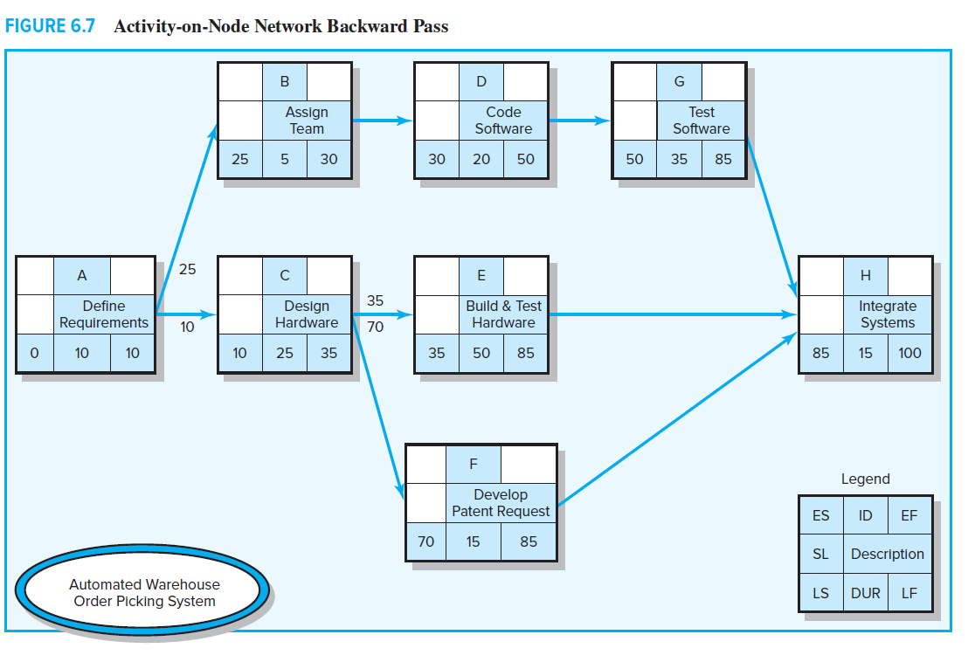

Slide 75
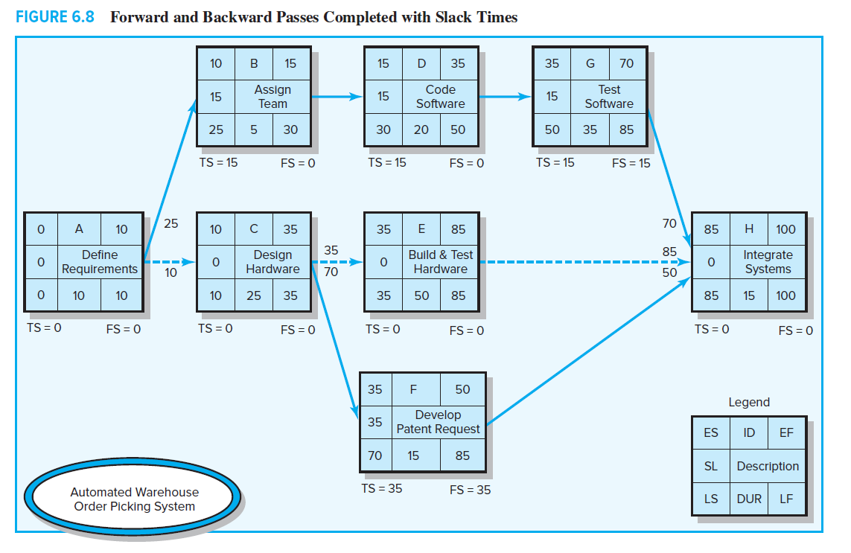

Slide 76
What are the critical paths?

Slide 77
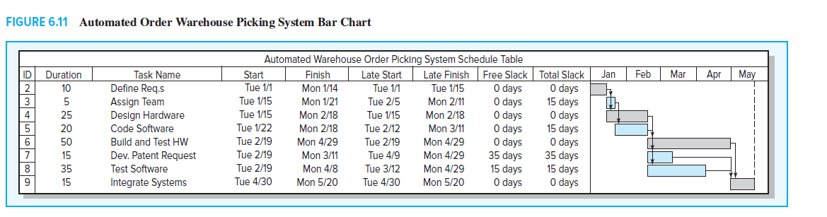
Gantt chart

Slide 78
Calendar Dates
Ultimately you will want to assign calendar dates to your project activities. If a computer program is not used, dates are assigned manually. Lay out a calendar of workdays (exclude non-workdays), and number them. Then relate the calendar workdays to the workdays on your project network. Most computer programs will assign calendar dates automatically after you identify start dates, time units, non-workdays, and other information.

Slide 79
Lecture 5:

Slide 80
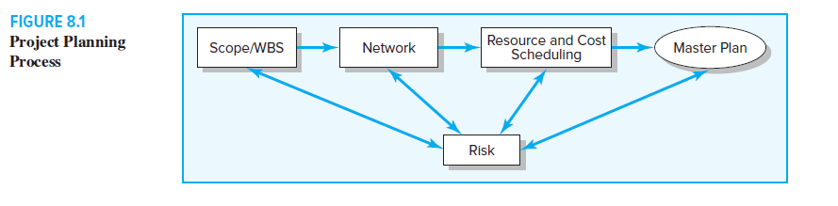
Main Steps in the project management

Slide 81
Types of Resource Constraints
People. This is the most obvious and important project resource. Human resources are usually classified by the skills they bring to the project—for example, programmer, mechanical engineer, welder, inspector, marketing director, supervisor. In rare cases some skills are interchangeable, but usually with a loss of productivity. The many differing skills of human resources add to the complexity of scheduling projects.
Materials. Project materials cover a large spectrum: for example, chemicals for a scientific project, concrete for a road project, survey data for a marketing project. Material availability and shortages have been blamed for the delay of many projects. When it is known that a lack of availability of materials is important and probable,
materials should be included in the project network plan and schedule. For example, delivery and placement of an oil rig tower in a Siberian oil field has a very small time window during one summer month.
Equipment. Equipment is usually presented by type, size, and quantity. In some cases equipment can be interchanged to improve schedules, but this is not typical. Equipment is often overlooked as a constraint. The most common oversight is to assume the resource pool is more than adequate for the project. For example, if a project needs one earthmoving tractor six months from now and the organization owns four, it is common
to assume the resource will not delay the pending project. However, when the earthmoving tractor is due on-site in six months, all four machines

Slide 82
Classification of a Scheduling Problem
A time-constrained project is one that must be completed by an imposed date. If required, resources can be added to ensure the project is completed by a specific date. Although time is the critical factor, resource usage should be no more than is necessary and sufficient.
A resource-constrained project is one that assumes the level of resources available cannot be exceeded. If the resources are inadequate, it will be acceptable to delay the project, but as little as possible.

Slide 83
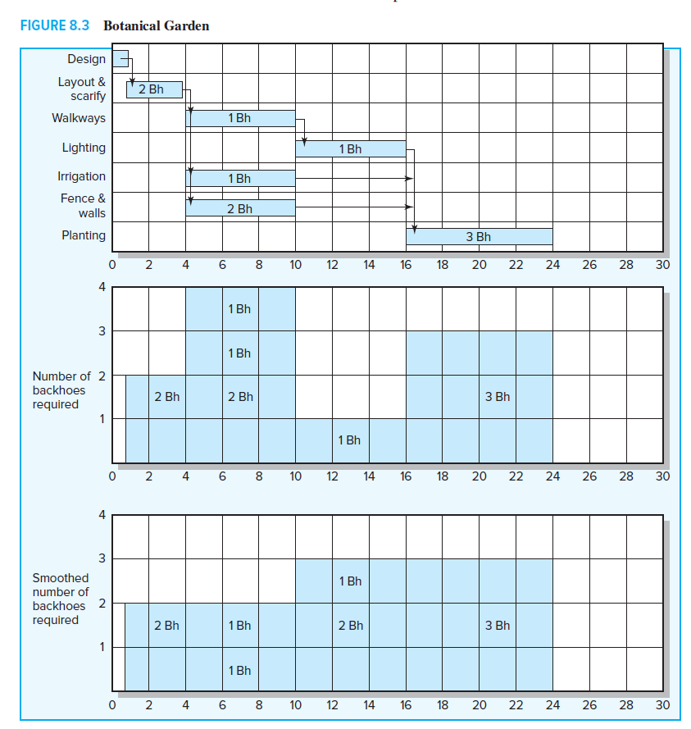
Resource Allocation Methods
For the purpose of demonstration, the Botanical Garden project uses only one resource (backhoes); all backhoes are interchangeable.

Slide 84
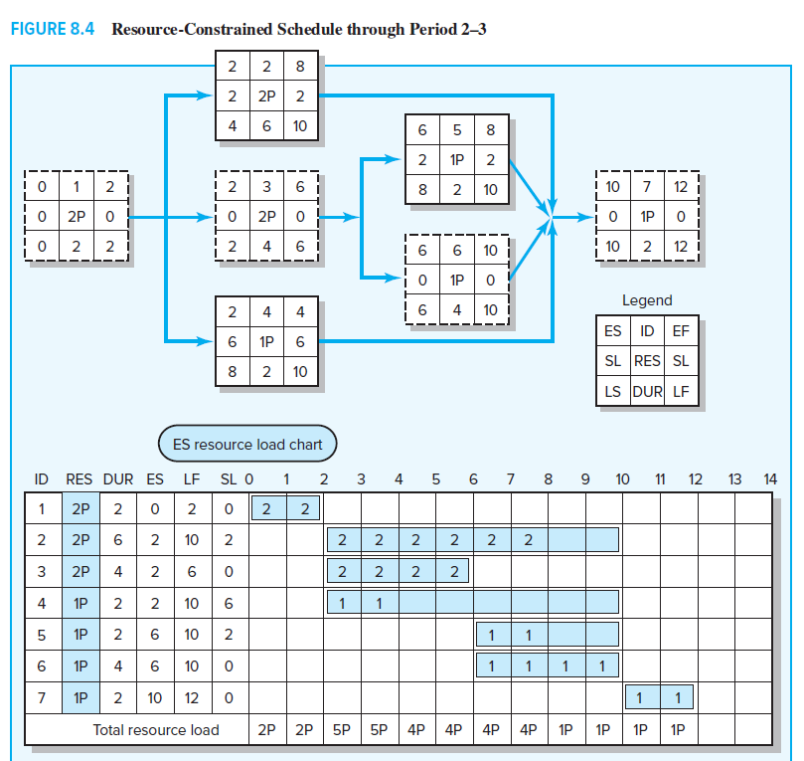

Slide 85
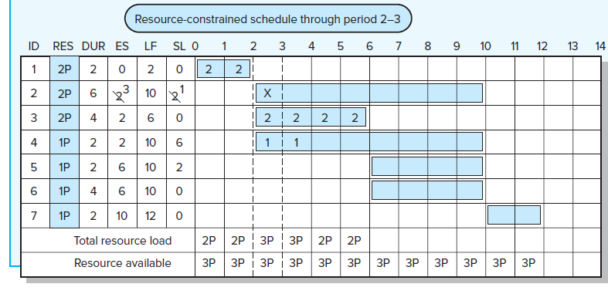

Slide 86
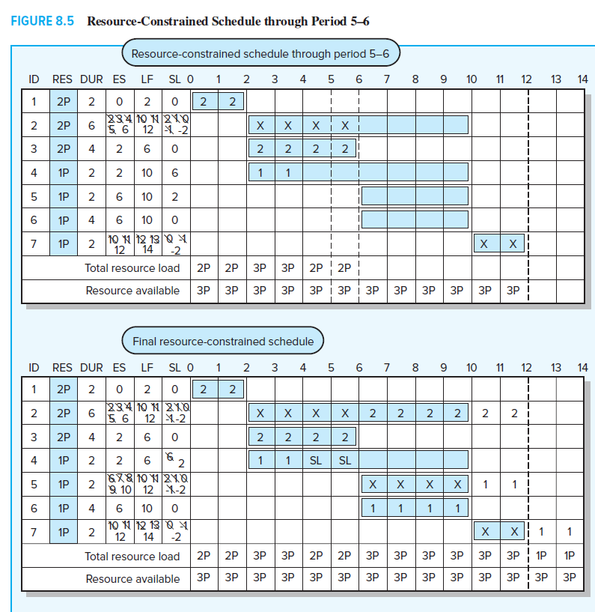

Slide 87

Final Program Network

Slide 88
Lecture 6: Budject Estimation

Slide 89
Why Estimating Time and Cost Is Important?

Slide 90
Creating a Time-Phased Budget
By using information from your WBS and resource schedule, you can create a time-phased
Cost baseline. Remember from the WBS for the PC Project. We integrated the WBS and OBS organization breakdown structure so the work packages could be tracked by deliverable and organization responsible. See Figure 8.12 for an example of the PC Prototype Project arranged by deliverable and organization unit responsible. For each intersection point of the WBS/OBS matrix, you see work package budgets and the total cost. The total cost at each intersection is called a cost or control account. For example, at the intersection of the Read/write head deliverable and the Production department we see there are three work packages with a total budget of $200,000.

Slide 92
Lecture 7: reducing the project time

Slide 93
There are many good reasons for attempting to reduce the duration of a project. One of the more important reasons today is time to market. Intense global competition and rapid technological advances have made speed a competitive advantage. To succeed, companies have to spot new opportunities, launch project teams, and bring new products or services to the marketplace in a flash. Perhaps in no industry does speed matter as much as in the electronics industry. For example, a rule of thumb for moderate- to high-technology firms is that a six-month delay in bringing a product to market can result in a loss of market share of about 35 percent.
Another common reason for reducing project time occurs when unforeseen delays— for example, adverse weather, design flaws, and equipment breakdown—cause substantial delays midway in the project. Getting back on schedule usually requires compressing the time on some of the remaining critical activities. The additional costs of getting back on schedule need to be compared with the consequences of being late. This is especially true when time is a top priority.

Slide 94
Options for Accelerating Project Completion
Adding Resources. The most common method for shortening project time is to assign additional staff and equipment to activities. There are limits, however, as to how much speed can be gained by adding staff. Doubling the size of the workforce will not necessarily reduce completion time by half.
For example, doubling a team by adding two workers requires six times as much pairwise intercommunication than is required in the original two-person team. Not only is more time needed to coordinate and manage a larger team; there is the additional delay of training the new people and getting them up to speed on the project. The end result is captured in Brooks’s law: Adding manpower to a late software project makes it later.
Frederick Brooks formulated this principle based on his experience as a project manager for IBM’s System/360 software project during the early 1960s. While subsequent research confirmed Brooks’s prediction, it also discovered that adding more people to a late project does not always cause the project to be later.2 The key is whether the new staff is added early so there is sufficient time to make up for lost ground once the new members have been fully assimilated.

Slide 95
Outsourcing Project Work A common method for shortening the project time is to subcontract an activity. The subcontractor may have access to superior technology or expertise that will accelerate the completion of the activity. For example, contracting for a backhoe can accomplish in two hours what it can take a team of laborers two days to do. Likewise, by hiring a consulting firm that specializes in ADSI programming, a firm may be able to cut in half the time it would take for less experienced, internal programmers to do the work. Subcontracting also frees up resources that can be assigned to a critical activity and will ideally result in a shorter project duration.

Slide 96
Lecture 8: Risk Management

